Slide 1
Calculation of Area of Substrate, Substance and Spheres

Slide 2
Interpretation Example
Given that our Area of Scan = 10цm * 10цm => 100цm²
From Cellpose plus, we extract
Area of Spheres = 43.34 цm²
Area of exclusively Substrate = 39.38 цm²
^{(i.e. Area without substance)}
Area of Substance = (Total area of Scan – Area of exclusively substrate)
Therefore = 100 – 39.38 = 61.62цm²
Therefore, the metric Ratio of
Area of Spheres/ Area of Substrate coated with Substance = 43.34/61.62
= 0.703

Slide 3
Area of Spheres, Substance & Substrate - Summarized
Sample | Area of Sphere (in um^2) | Area of Substrate(in um^2) | Area of Substance(in um^2)
A | 44.24 | 18.38 | 81.62
Б | 44.34 | 39.68 | 60.32
В | 12.25 | 9.79 | 90.21
Г | 32.81 | 0 | 100
Д | 7.42 | 0 | 100
Е | 3.34 | 0 | 100
Ж | 45.1 | 5.46 | 94.54
З | 3.91 | 0 | 100
И | 0 | 0 | 100
К | 43.23 | 3.34 | 96.66
Л | 24.74 | 0 | 100
М | 26.29 | 3.69 | 96.31
Н | 24.74 | 0 | 100
О | 0 | 5.82 | 94.18

Slide 4
(А)- 156 – CHCl₃ - 23ºC – 23ºC – 10⁻⁴M
Original Image
Gwyddion Mask
Masked % | 14.95
Mask Height Value (цm) | 5.496

Slide 5
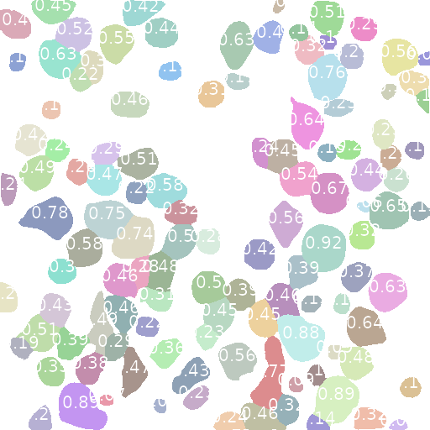
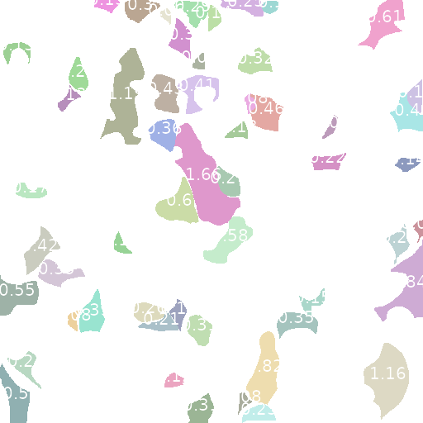
(А)- 156 – CHCl₃ - 23ºC – 23ºC – 10⁻⁴M
Spheres
Substance
Area of Spheres = 44.24цm²
Area of Substrate = 18.38цm²

Slide 6
(Б)- 156 – CHCl₃ – 23ºC – 4ºC – 10⁻⁴M
(Б)- 156 – CHCl₃ – 23ºC – 4ºC – 10⁻⁴M
Original Image
Gwyddion Mask
Masked % | 28.04
Mask Height Value (цm) | 16.91

Slide 7

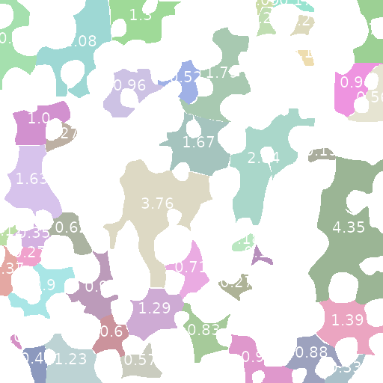
(Б)- 156 – CHCl₃ – 23ºC – 4ºC – 10⁻⁴M
Spheres
Substance
Area of Spheres = 43.34цm²
Area of Substrate = 39.68цm²

Slide 8
(В)- 156 – CHCl₃ - 4ºC – 23ºC – 10⁻⁴M
Original Image
Gwyddion Mask
Masked % | 21.60
Mask Height Value (цm) | 5.04

Slide 9
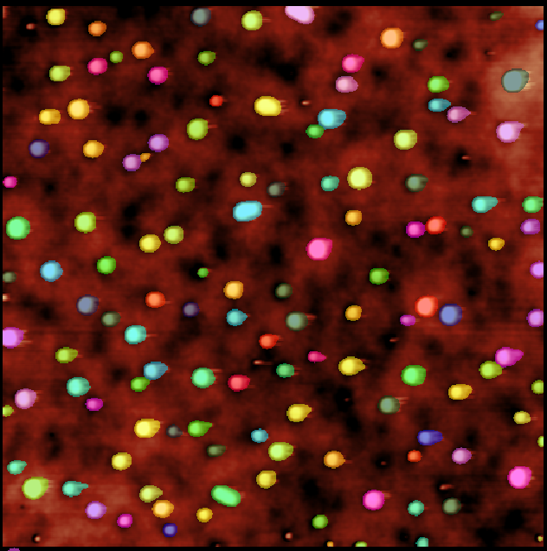
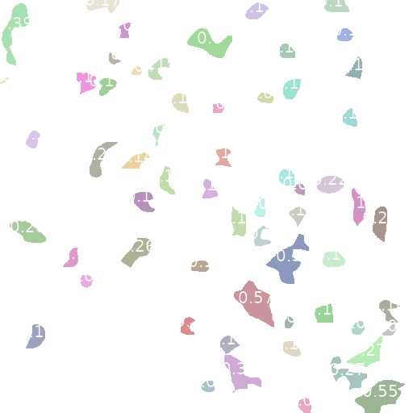
(В)- 156 – CHCl₃ - 4ºC – 23ºC – 10⁻⁴M
Spheres
Substance
Area of Spheres = 12.25цm²
Area of Substrate = 9.79цm²

Slide 10
(Г)- 156 – CHCl₃ - 23ºC – 23ºC – 10⁻⁵M
Original Image
Gwyddion Mask
Masked % | 22.43
Mask Height Value (цm) | 24.82

Slide 11
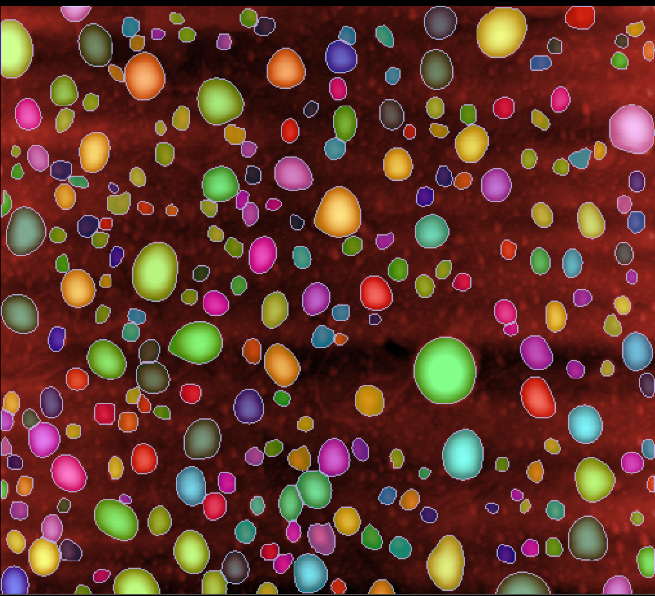
(Г)- 156 – CHCl₃ - 23ºC – 23ºC – 10⁻⁵M
Spheres
Substance
Area of Spheres = 32.81цm²
Area of Substrate = 100цm² or area of full substrate/spheres

Slide 12
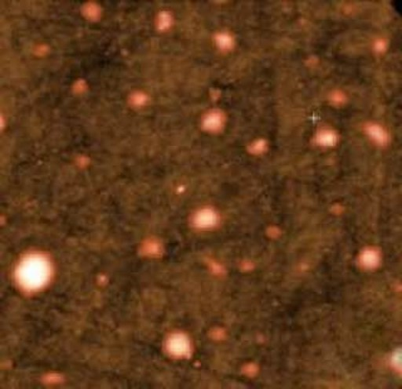
(Д)- 156 – CHCl₃+H₂O - 23ºC – 23ºC – 10⁻⁴M
Original Image
Gwyddion Mask
Masked %
Mask Height Value (цm)

Slide 13
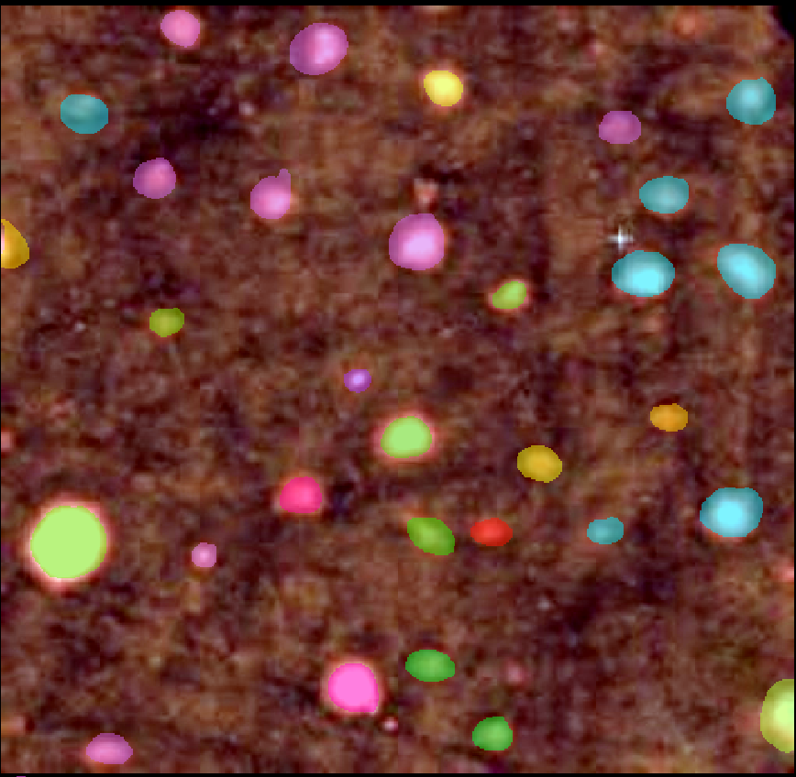
(Д)- 156 – CHCl₃+H₂O - 23ºC – 23ºC – 10⁻⁴M
Spheres
Substance
Area of Spheres = 7.42цm²
Area of Substrate = 100цm² or area of full substrate/spheres

Slide 14
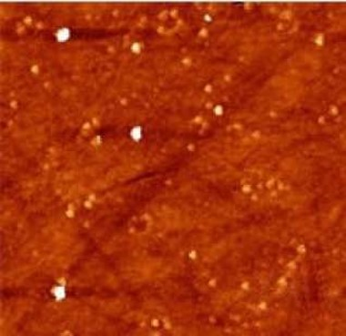
(Е)- 156 – CHCl₃+H₂O - 23ºC – 23ºC – 10⁻⁵M
Original Image
Gwyddion Mask
Masked %
Mask Height Value (цm)

Slide 15
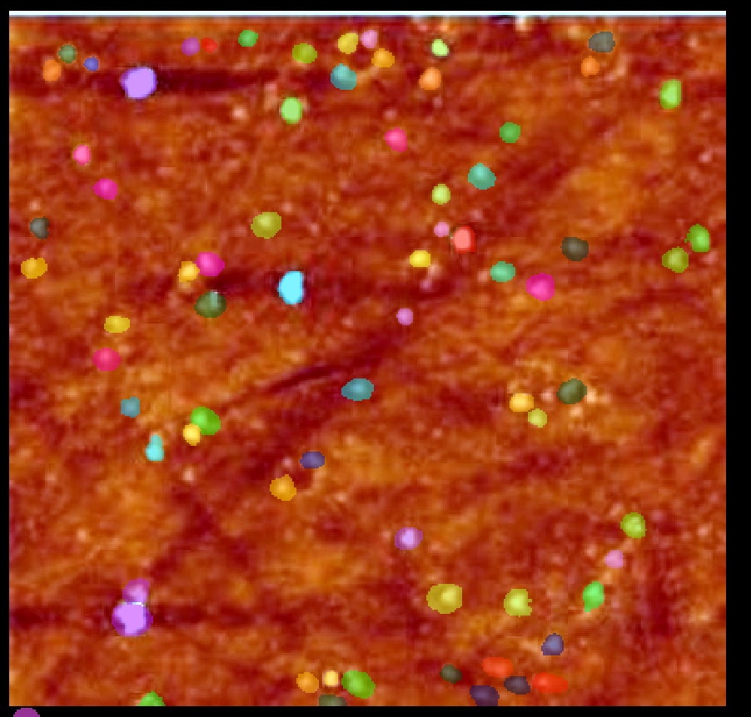
(Е)- 156 – CHCl₃+H₂O - 23ºC – 23ºC – 10⁻⁵M
Spheres
Substance
Area of Spheres = 3.34цm²
Area of Substrate = 100цm² or area of full substrate/spheres

Slide 16
(Ж)- 156 – Toluene - 23ºC – 4ºC – 10⁻⁴M
Original Image
Gwyddion Mask
Masked % | 32.71
Mask Height Value (цm) | 32.150

Slide 17
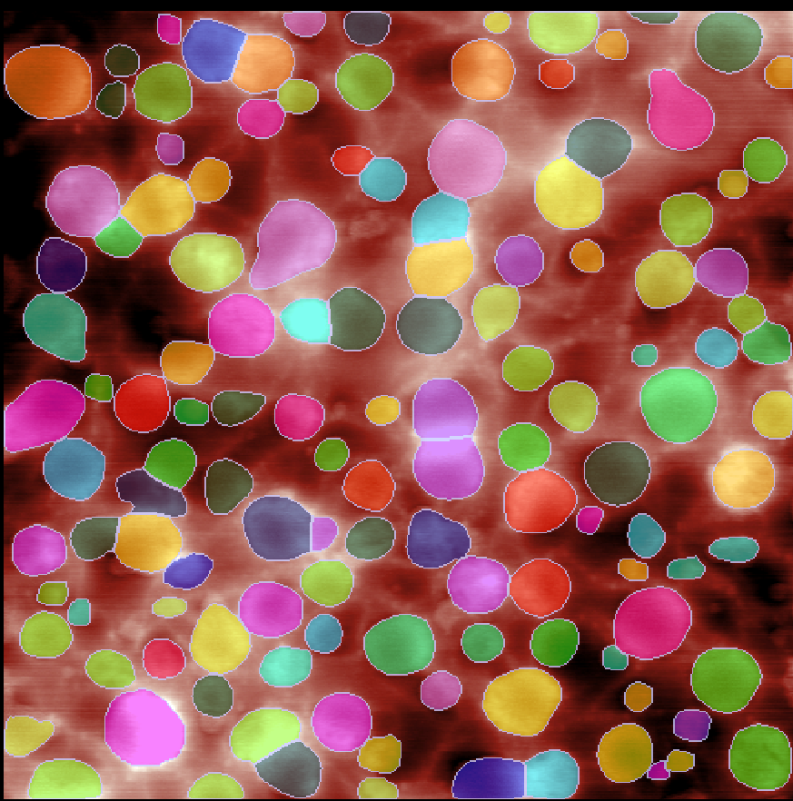
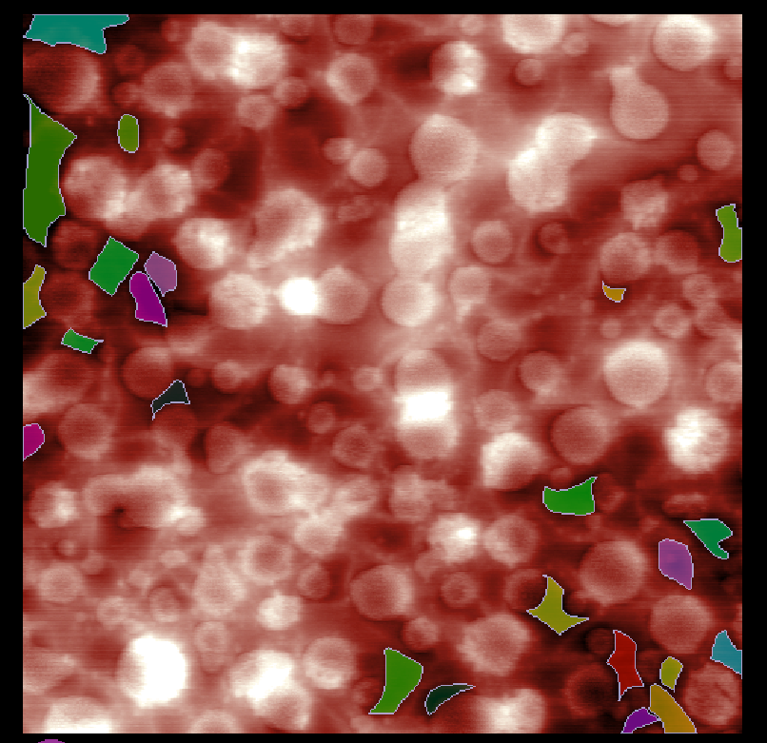
(Ж)- 156 – Toluene - 23ºC – 4ºC – 10⁻⁴M
Spheres
Substance
Area of Spheres = 45.1цm²
Area of Substrate = 5.46цm²

Slide 18
(З)- 156 – Toluene - 23ºC – 23ºC – 10⁻⁵M
Original Image
Gwyddion Mask
In this sample, I have applied Polynomial Plan Levelling with degree = 2
Masked % | 18.71
Mask Height Value (цm) | 12.962

Slide 19
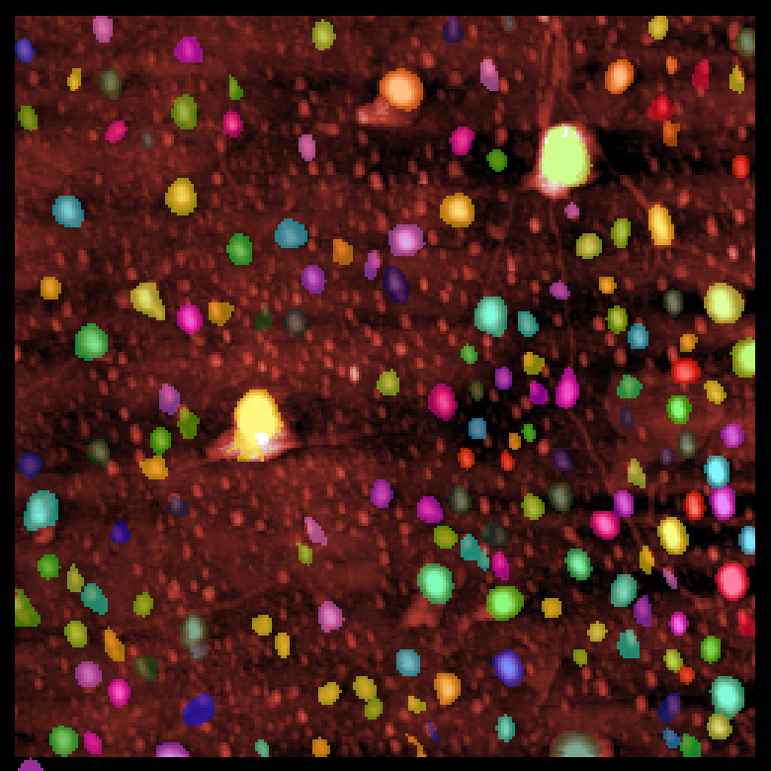
(З)- 156 – Toluene - 23ºC – 23ºC – 10⁻⁵M
Spheres
Substance
Area of Spheres = 3.91цm²
Area of Substrate = 100цm² or area of full substrate/spheres

Slide 20
(И)- 159 – CHCl₃ - 23ºC – 23ºC – 10⁻⁴M
Original Image
Gwyddion Mask
Masked % | 24.30
Mask Height Value (цm) | 26.69

Slide 21
(И)- 159 – CHCl₃ - 23ºC – 23ºC – 10⁻⁴M
Spheres
Substance
Area of Spheres = 0цm²
Area of Substrate = 100цm² or area of full substrate/spheres

Slide 22
(К)- 159 – CHCl₃ - 23ºC – 23ºC – 10⁻⁵M
Original Image
Gwyddion Mask
Masked % | 31.78
Mask Height Value (цm) | 21.698

Slide 23
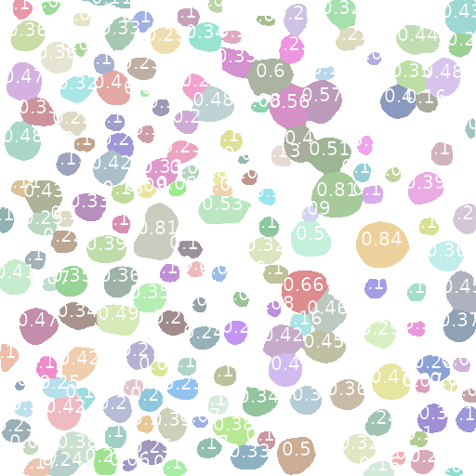

(К)- 159 – CHCl₃ - 23ºC – 23ºC – 10⁻⁵M
Spheres
Substance
Area of Spheres = 43.23цm²
Area of Substrate = 3.34цm²

Slide 24
(Л)- 159 – Toluene - 23ºC – 23ºC – 10⁻⁴M
Original Image
Gwyddion Mask
Masked % | 15.89
Mask Height Value (цm) | 17.00

Slide 25
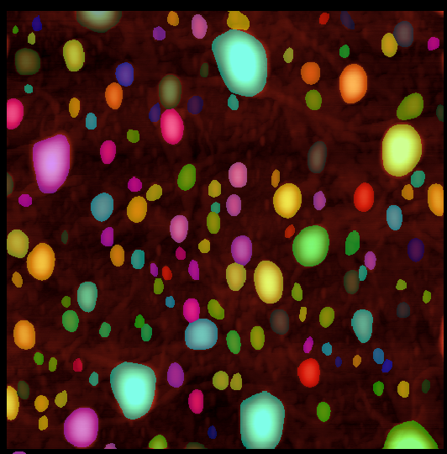
(Л)- 159 – Toluene - 23ºC – 23ºC – 10⁻⁴M
Spheres
Substance
Area of Spheres = 24.74цm²
Area of Substrate = 100цm² or area of full substrate/spheres

Slide 26
(М)- 159 – Toluene - 23ºC – 23ºC – 10⁻⁵M
Original Image
Gwyddion Mask
In this sample, I have applied Polynomial Plan Levelling with degree = 2, since there are too many horizonal scratches
Masked % | 23.36
Mask Height Value (цm) | 9.139

Slide 27

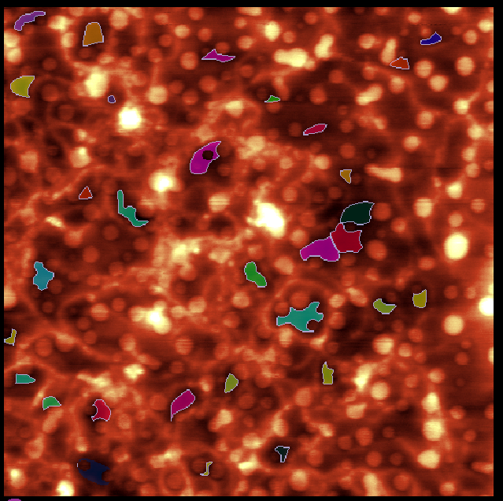
(А)- 156 – CHCl₃ - 23ºC – 23ºC – 10⁻⁴M
Spheres
Substance
Area of Spheres = 26.29цm²
Area of Substrate = 3.69цm²

Slide 28
(Н)- 159 – CHCl₃ - 23ºC - 4ºC – 10⁻⁴
Original Image
Gwyddion Mask
Masked % | 14.02
Mask Height Value (цm) | 14.41

Slide 29
(А)- 156 – CHCl₃ - 23ºC – 23ºC – 10⁻⁴M
Spheres
Substance
Area of Spheres = 24.74цm²
Area of Substrate = 100цm² or area of full substrate/spheres

Slide 30
(О)- 159 – CHCl₃ - 4ºC – 23ºC – 10⁻⁴M
Original Image
Gwyddion Mask
Masked % | 17.76
Mask Height Value (цm) | 62.02

Slide 31
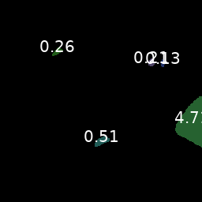
(А)- 156 – CHCl₃ - 23ºC – 23ºC – 10⁻⁴M
Spheres
Substance
Area of Spheres = 0 цm²
Area of Substrate = 5.82цm²

